Slide 1
Seeing and changing permissions
30
A crash intro: the shell, permissions and files

Slide 2
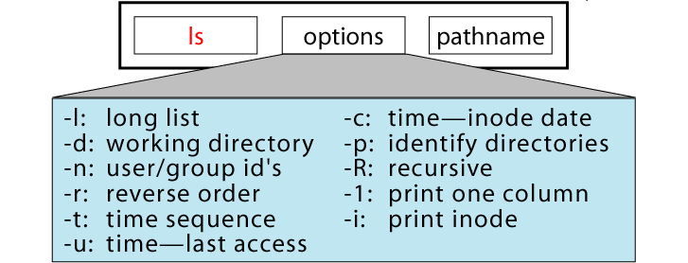
Seeing permissions
Which command do we use to see what’s in a directory?
ls
Just typing ls shows you what is in the folder, and that’s it. You don’t know who has what permissions, the size of the file, last time someone touched them, etc.
So it’s more common to type ls -als
31
A crash intro: the shell, permissions and files

Slide 3
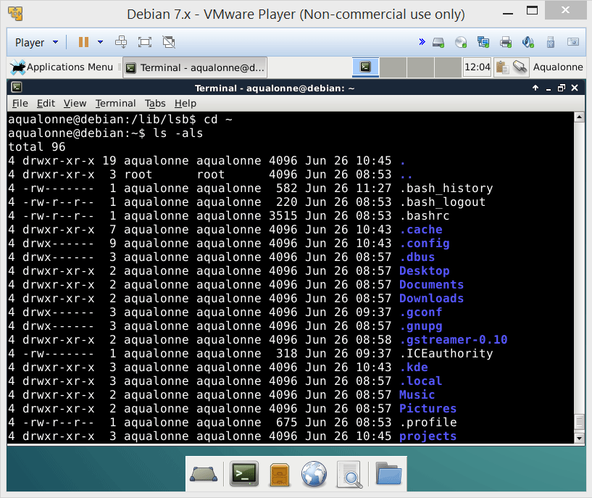
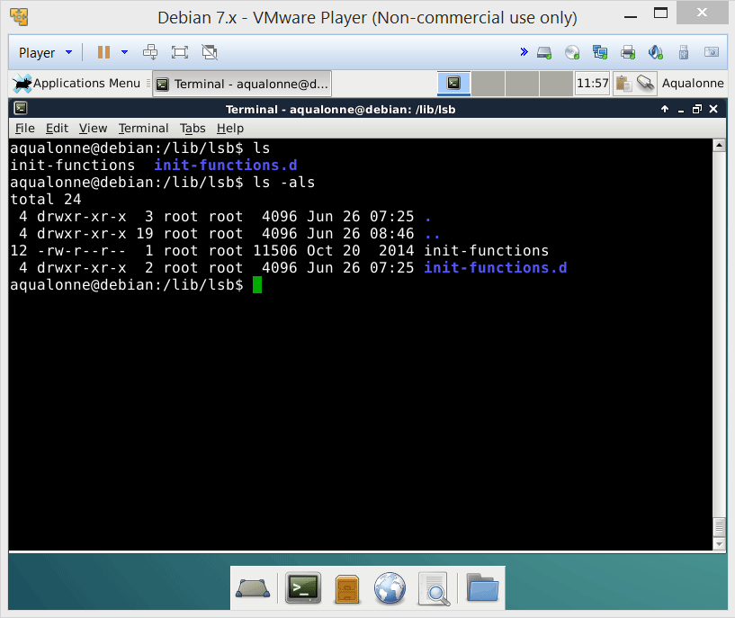
Seeing permissions
Last changed
.
Files that start with a dot are hidden
Owner
Group
Name
Size
Permissions
File type (d for directory)
32
A crash intro: the shell, permissions and files

Slide 4
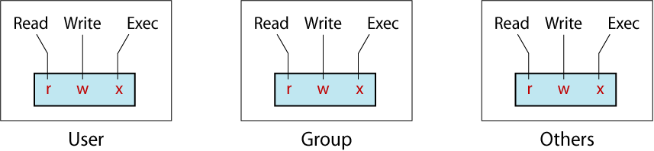
Seeing permissions
rwxr-xr-x?? wtf???
Access Type | Meaning on File | Meaning on Dir.
r (read) | View file contents (open, read) | List directory contents
w (write) | Change file contents | Change directory contents
x (execute) | Run executable file | Make it current directory Access files in it
- | Permission denied | Permission denied
33
A crash intro: the shell, permissions and files

Slide 5
Seeing permissions
rwx
r-x
r-x
If it’s your file, you should have rwx on it, and others should not have w. If you work with people on the same files it’s ok to have w for the group. If the file is private, everybody else gets - - -
Person who made the file
(user)
People in the same group as the user’s
People in other groups
Can read, write, and run the file.
Can read and run, but not write.
Can read & run, but not write.
34
A crash intro: the shell, permissions and files

Slide 6
Seeing permissions
rw-
-w-
-w-
Person who made the file
(user)
People in the same group as the user’s
People in other groups
Can read and write
Can only write
Can only write
35
A crash intro: the shell, permissions and files

Slide 7
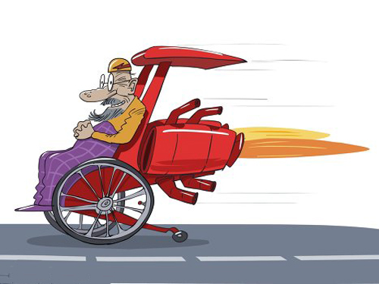
Up to that part of the lecture, you were told what the user needs to know.
We’re now going to look at what the admin needs to know. It’s gonna be a bit complicated...
36
A crash intro: the shell, permissions and files

Slide 8
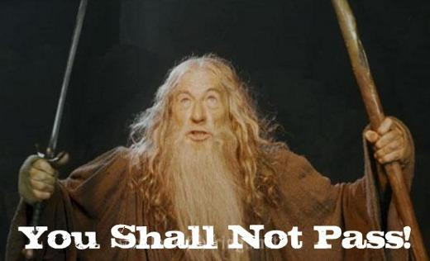
Managing permissions
The admin side of the story
37
A crash intro: the shell, permissions and files

Slide 9
Seeing permissions
Owner
Group
Permissions
File type (d for directory)
If I am logged as any user, can I read the init-functions file?
Yes, because the ‘other’ block has r-- and is for reading
If I’m in the root’s group, can I change the init-functions.d?
No, because the ‘group’ block has r-x and w is needed
If I’m root, can I run the init-functions file?
No, because it’s got rw- but x is needed
38
A crash intro: the shell, permissions and files

Slide 10
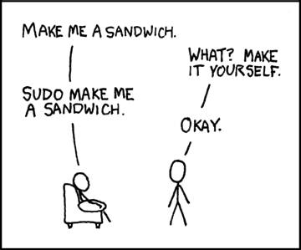
Who can change permissions?
Take a few seconds to think about who should be able to...
The root user?
Yes. The root is almighty anyway.
People having the ‘w’ permission?
NO!!! Otherwise you may create a file, share it with a colleague, and they may kick you out of your file.
The owner of the file?
Yes. Because access to permissions is all about ownership.
39
A crash intro: the shell, permissions and files

Slide 11
Who can change permissions?
Owner
40
A crash intro: the shell, permissions and files

Slide 12
Changing permissions
Optional
-R for recursive will apply the new permissions to everything from that folder
chmod
options
who
operations
permission
file
u for user
g for group
o for others
a for all
+ for add
- for remove
= for assign
r for read
w for write
x for execute
% chmod ug=rwx,o=rx sort.c
% chmod ugo+rx,go+w sort.c
% chmod u=rwx,g+w,o-w memo.doc
Examples:
41
A crash intro: the shell, permissions and files

Slide 13

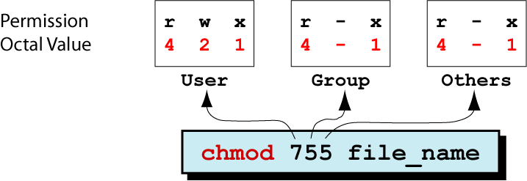
Changing permissions
% chmod ug=rwx,o=rx sort.c
% chmod ugo+rx,go+w sort.c
% chmod u=rwx,g+w,o-w memo.doc
We tend to see this style as being really, really ugly.
Instead, we prefer to use the octal value. It’s very short so after some practice you get used to it. Whereas the long one, even after practice, stays long.
To understand what’s going on, we need to understand a little bit about binary coding. So, short aside...
42
A crash intro: the shell, permissions and files

Slide 14
How do you encode numbers using only 0s and 1s?
Everyday, we encode all the numbers we want using only ten signs:
0 1 2 3 4 5 6 7 8 9
decimal
We put these signs next to each others, and their position stands for a power of 10:
7829
= 7 x 1000 + 8 x 100 + 2 x 10 + 9 x 1
3
0
10
10
2
10
1
10
binary
When we have only two signs, their position stands for a power of 2.
1
0
1
1
= 1 x 8 + 0 x 4 + 1 x 2 + 1 x 1
(= eleven for us)
3
2
1
0
2
2
2
2
43
A crash intro: the shell, permissions and files

Slide 15
How do you encode numbers using only 0s and 1s?
Exponent | Value
0 | 1
1 | 2
2 | 4
3 | 8
4 | 16
5 | 32
6 | 64
7 | 128
8 | 256
9 | 512
10 | 1024
1 0 1 1
1
+ 8
= 11
+ 2
Practice question#1
Here is a binary number. What decimal number is it?
Table of powers of 2
Memorize this table in order to decode binary numbers fast!
44
A crash intro: the shell, permissions and files

Slide 16
How do you encode numbers using only 0s and 1s?
Exponent | Value
0 | 1
1 | 2
2 | 4
3 | 8
4 | 16
5 | 32
6 | 64
7 | 128
8 | 256
9 | 512
10 | 1024
1000100
4
= 68
+ 64
Practice question#2
Here is a binary number. What decimal number is it?
Table of powers of 2
Memorize this table in order to decode binary numbers fast!
45
A crash intro: the shell, permissions and files

Slide 17
How do you encode numbers using only 0s and 1s?
Exponent | Value
0 | 1
1 | 2
2 | 4
3 | 8
4 | 16
5 | 32
6 | 64
7 | 128
8 | 256
9 | 512
10 | 1024
1 1 0 1 0 1
1
+ 16
+ 32
= 53
+ 4
Practice question#3
Here is a binary number. What decimal number is it?
Table of powers of 2
Memorize this table in order to decode binary numbers fast!
46
A crash intro: the shell, permissions and files

Slide 18
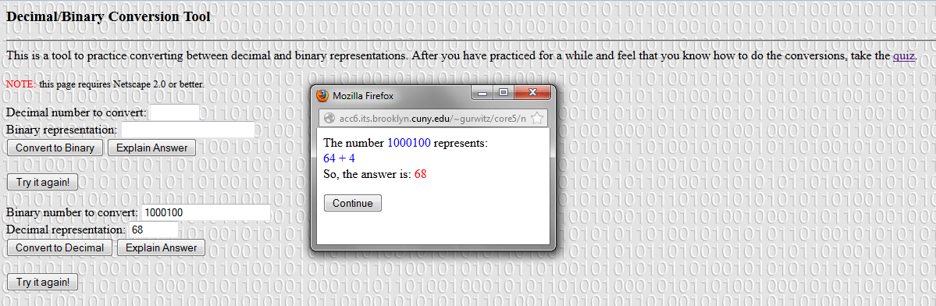
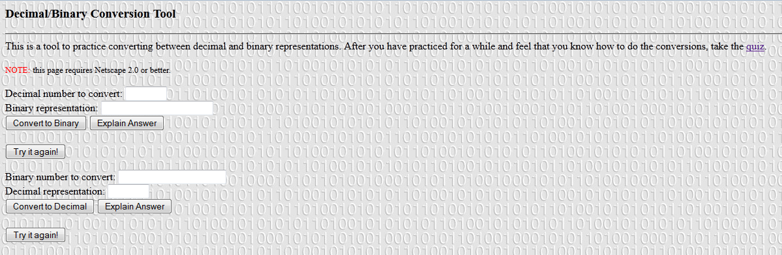
How do you encode numbers using only 0s and 1s?
http://acc6.its.brooklyn.cuny.edu/~gurwitz/core5/nav2tool.html
47
A crash intro: the shell, permissions and files

Slide 19
Changing permissions
Detailed step-by-step approach to setting permissions by octal value:
Step | Perform… | Settings
1 | List the desired setting
2 | Assign binary: 1 for access; 0 for no access
3 | List octal values for the corresponding binary 1’s
4 | Convert the octal values to a 3-digit number
5 | Write the command
rwx|rwx|r-x
111|111|101
421|421|401
7 | 7 | 5
chmod 775 sort.c
48
A crash intro: the shell, permissions and files

Slide 20
Changing permissions
Faster approach to setting octal values:
For each of the three groups (you-friends-strangers):
To allow reading, +4
To allow writing, +2
To allow running, +1
My file is totally private, nobody else should do a thing on it.
chmod 700 file.doc
Examples:
I work on my file with my group
chmod 770 file.doc
It’s ok if anybody uses my file but only I can modify it
chmod 755 file.doc
49
A crash intro: the shell, permissions and files

Slide 21

Permissions are all about security.
When you learn about how security works for a system, what’s the first question you should ask yourself?
“How can I bypass it?”
50
A crash intro: the shell, permissions and files

Slide 22
Imagine that you have rw- access on a file. So you can’t run it, but you’d like to. What can you do?
51
A crash intro: the shell, permissions and files

Slide 23
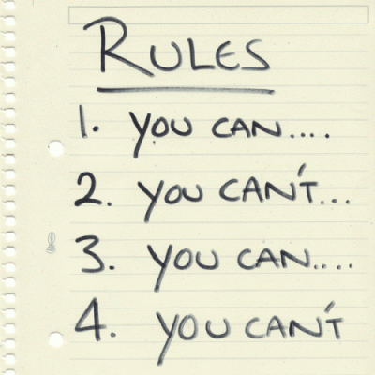
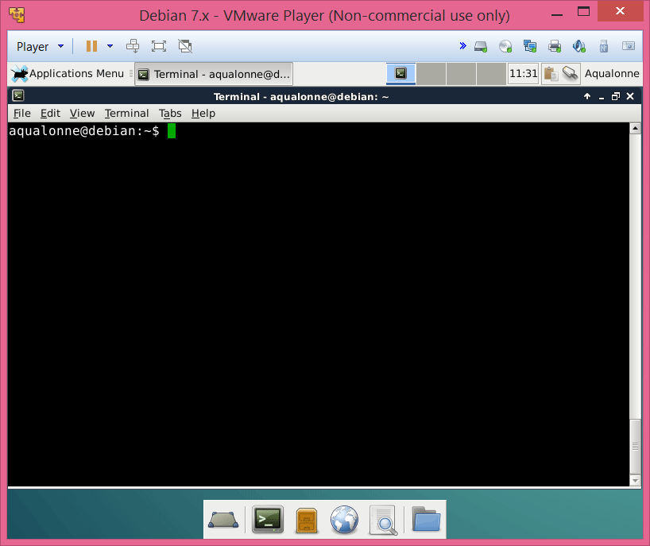
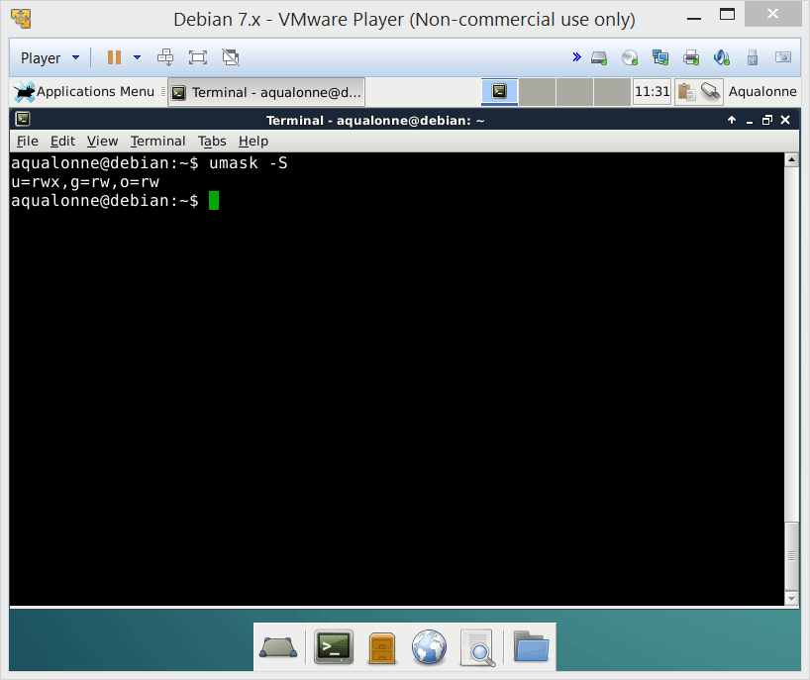
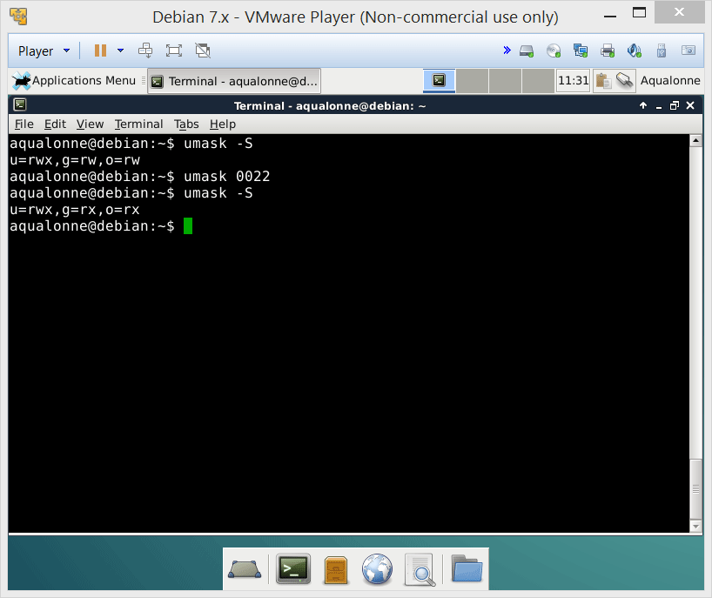

Default permissions
The admin sets the rules: these are the default permissions that all new files and folders will have
The value you give in umask is not the value that you want for permissions!
These are the default permissions.
If you want everybody to do anything, umask 777 is not going to give you that!!!
If you want to change the default permissions, you use umask with a value.
52
A crash intro: the shell, permissions and files

Slide 24
Default permissions
These are the permissions your system starts with:
Directory File
rwx rwx rwx rw- rw- rw-
111 111 111 110 110 110
& 111 101 101 & 111 101 101
111 101 101 110 100 100
rwx r-x r-x rw- r-- r--
Umask “filters” from these permissions
umask 022
To binary
Swap
000 010 010
111 101 101
53
A crash intro: the shell, permissions and files

Slide 25
Default permissions
These are the permissions your system starts with:
Directory File
rwx rwx rwx rw- rw- rw-
111 111 111 110 110 110
& 010 010 010 & 010 010 010
010 010 010 010 010 010
-w- -w- -w- -w- -w- -w-
Umask “filters” from these permissions
umask 555
To binary
Swap
101 101 101
010 010 010
54
A crash intro: the shell, permissions and files

Slide 26
Default permissions
User mask Value | Directory Default: 777 | File Default: 666
000 | 777 (rwx rwx rwx) | 666 (rw- rw- rw-)
111 | 666 (rw- rw- rw-) | 666 (rw- rw- rw-)
222 | 555 (r-x r-x r-x) | 444 (r- - r- - r- -)
333 | 444 (r- - r- - r- -) | 444 (r- - r- - r- -)
444 | 333 (-wx –wx –rx) | 222 (-w- -w- -w-)
555 | 222 (-w- -w- -w-) | 222 (-w- -w- -w-)
666 | 111 (- -x - -x - -x) | 000 (--- --- --- )
777 | 000 (--- --- --- ) | 000 (--- --- --- )
55
A crash intro: the shell, permissions and files

Slide 27
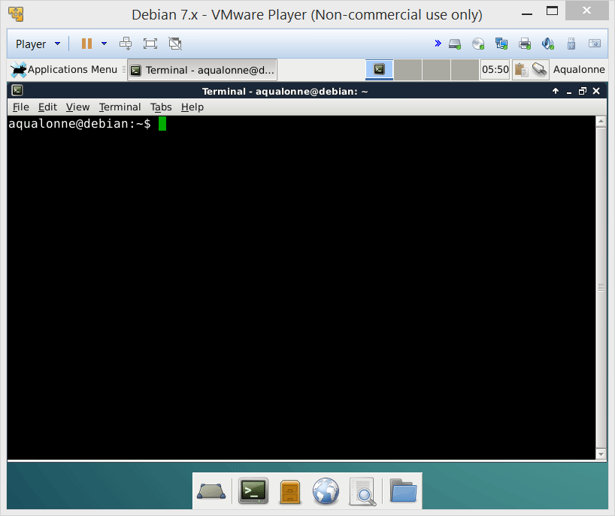
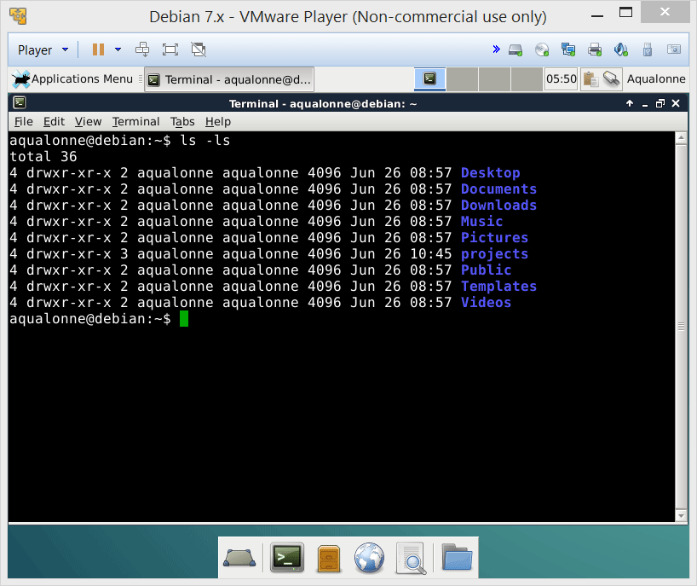
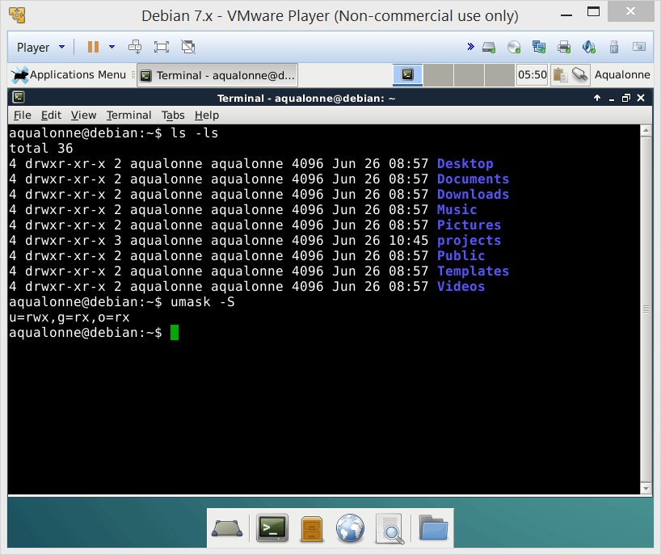
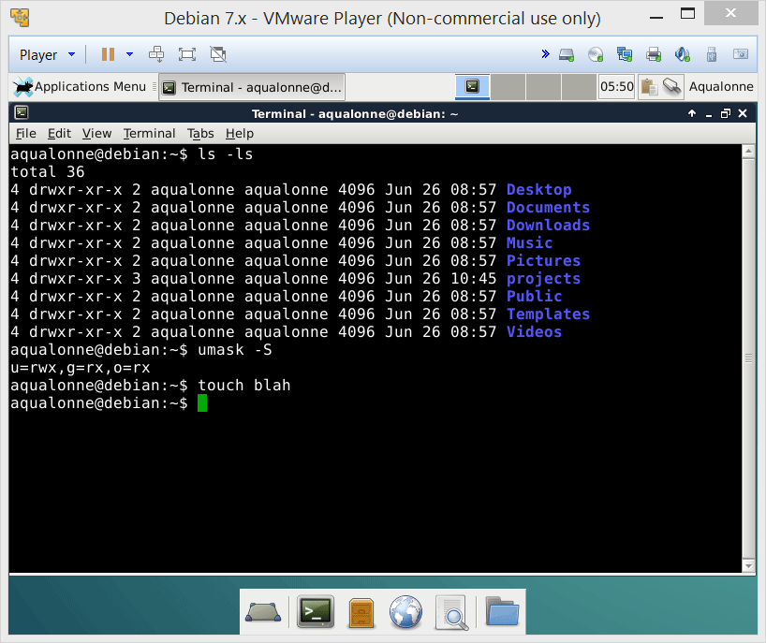
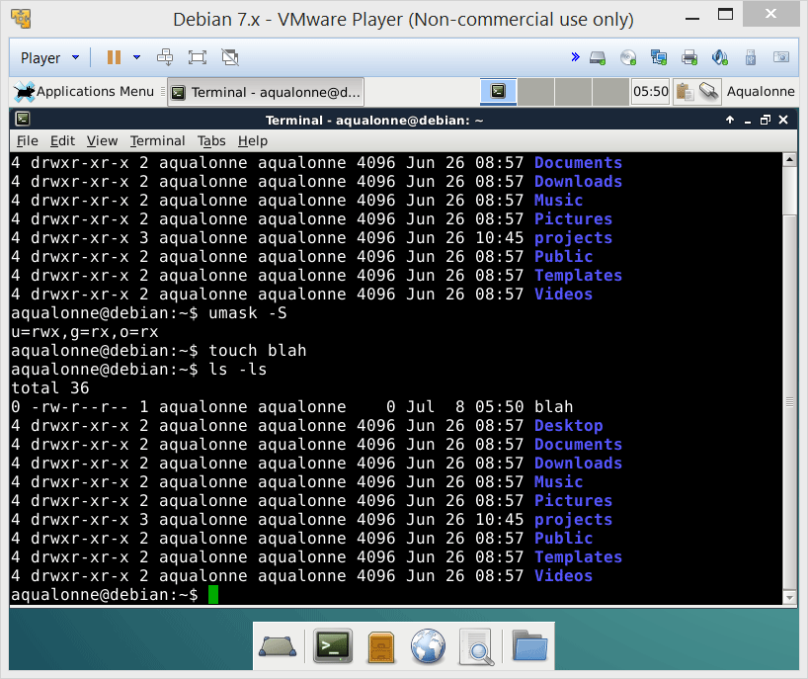
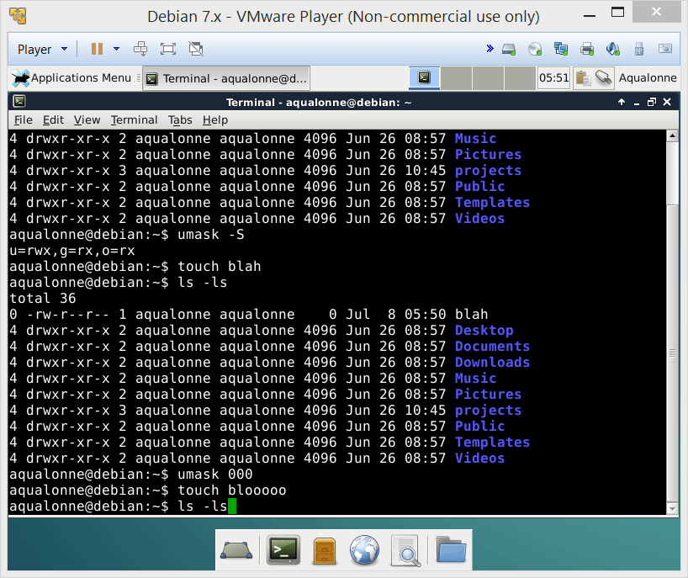
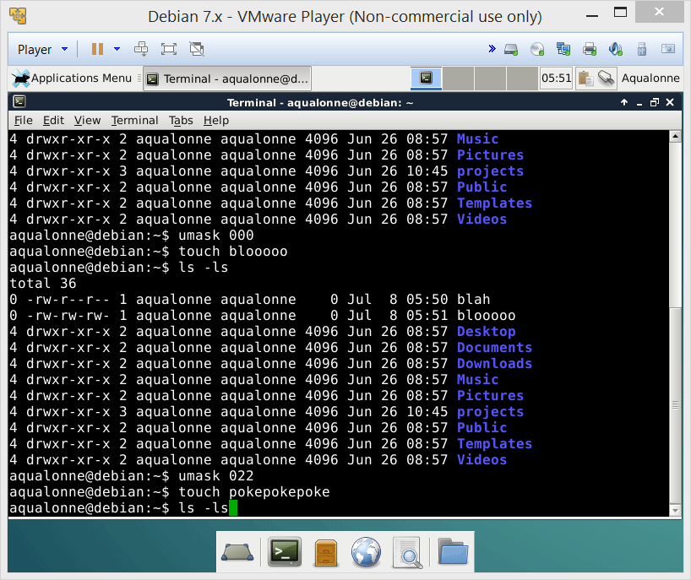
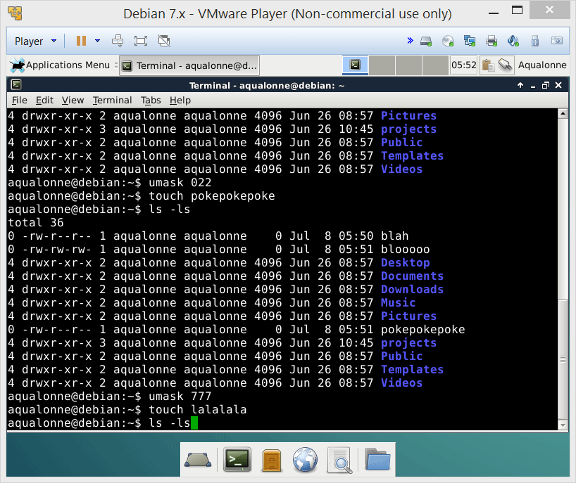
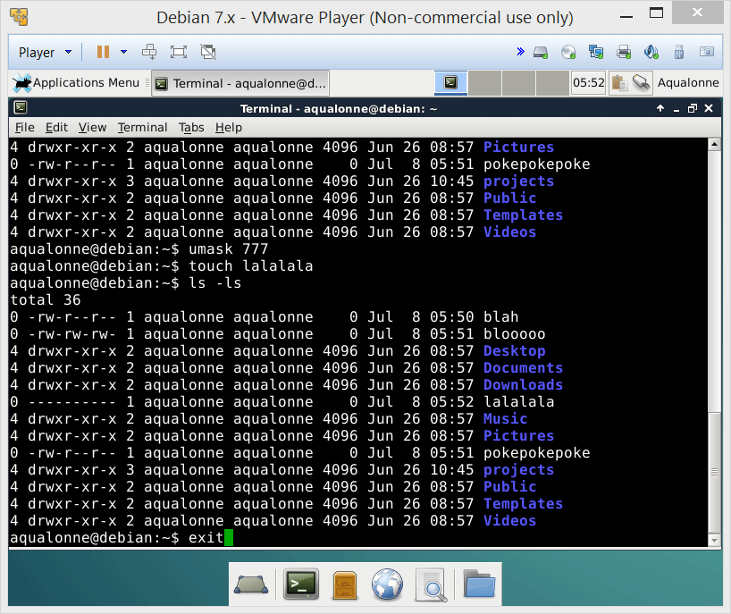
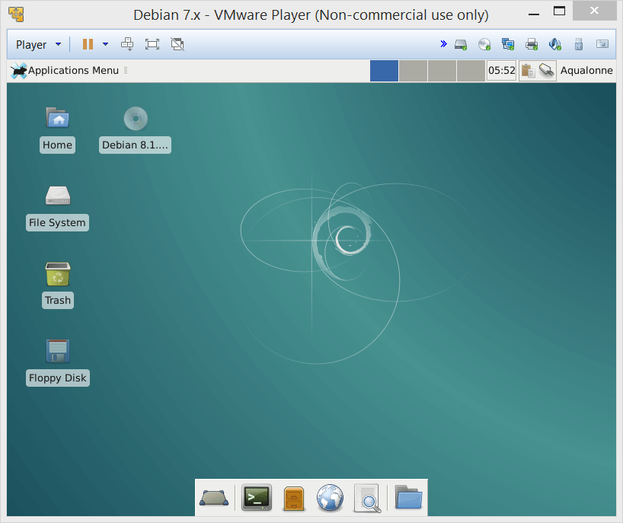

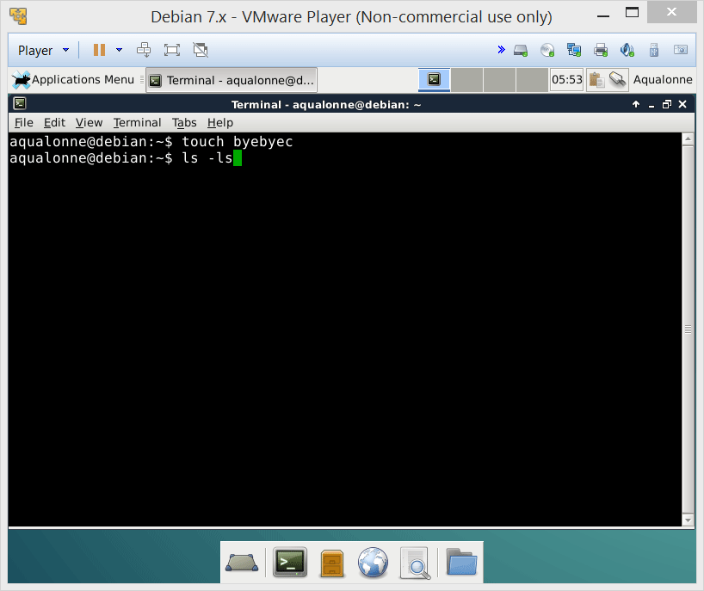
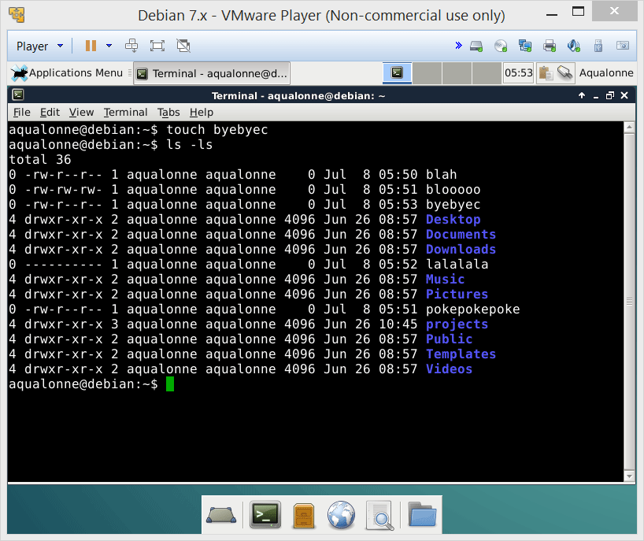
Default permissions
Use touch to make an empty file
56
A crash intro: the shell, permissions and files

Slide 28
Complex permissions
57
A crash intro: the shell, permissions and files

Slide 29

rwx
user ID
group ID
sticky bit
Attributes
Access control lists
58
A crash intro: the shell, permissions and files

Slide 30
What are they?
SUID (Set owner User ID up on execution)
Run a program with the permissions of the user the program belongs to, not your own
Example
To change your password, you need to edit system files /etc/passwd that belong to the root
So passwd belongs to the root and it set with SUID to give root permissions.
“lean” concept for the security of files and directories
suid | sgid | stb | r | w | x | r | w | x | r | w | x
4 | 2 | 1 | 4 | 2 | 1 | 4 | 2 | 1 | 4 | 2 | 1
7 |  |  | 7 |  |  | 7 |  |  | 7
Special |  |  | user |  |  | group |  |  | others
59
A crash intro: the shell, permissions and files

Slide 31
What are they?
SGID (Set Group ID up on execution)
Run a program with the permissions of the group the program belongs to, not your group’s
Example
Enforcing quotas: if anybody starts dumping data into a directory, it takes quota from the group the directory belongs to.
“lean” concept for the security of files and directories
suid | sgid | stb | r | w | x | r | w | x | r | w | x
4 | 2 | 1 | 4 | 2 | 1 | 4 | 2 | 1 | 4 | 2 | 1
7 |  |  | 7 |  |  | 7 |  |  | 7
Special |  |  | user |  |  | group |  |  | others
60
A crash intro: the shell, permissions and files

Slide 32
What are they?
STB (STicky Bit)
Only the owner or root can delete or rename the file.
Example
If you have write/execute permissions for a directory, you can trash its content even if you don’t own it. So one user could delete the /tmp folder that others use. So tmp has STB.
“lean” concept for the security of files and directories
suid | sgid | stb | r | w | x | r | w | x | r | w | x
4 | 2 | 1 | 4 | 2 | 1 | 4 | 2 | 1 | 4 | 2 | 1
7 |  |  | 7 |  |  | 7 |  |  | 7
Special |  |  | user |  |  | group |  |  | others
61
A crash intro: the shell, permissions and files

Slide 33
How to see them
The ls –l command doesn’t have a section for special permissions. But since these permissions require execute rights, they replace the ‘x’ when displayed:
r w x r w x r w x
r w s r w s r w t
SUID
SGID
STICKY
BIT
If they are set on a file without execute permission, they show up as capital:
r w - r w - r w -
r w S r w S r w T
SUID
SGID
STICKY
BIT
62
A crash intro: the shell, permissions and files

Slide 34
How to change them
Use chmod like for anything else. You just have 4 numbers instead of 3 now:
chmod 4522
suid | sgid | stb | r | w | x | r | w | x | r | w | x
4 | 2 | 1 | 4 | 2 | 1 | 4 | 2 | 1 | 4 | 2 | 1
7 |  |  | 7 |  |  | 7 |  |  | 7
Special |  |  | user |  |  | group |  |  | others
63
A crash intro: the shell, permissions and files

Slide 35
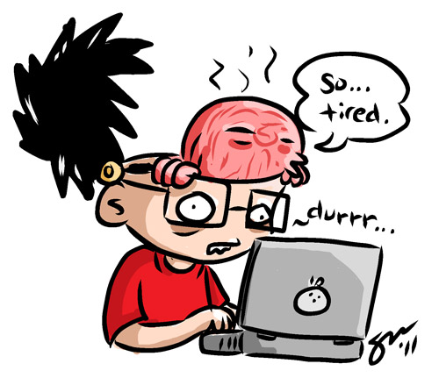
Let’s be fair. Permissions are not the most thrilling topic ever. But it’s necessary to understand access control and safety in a system if you want to manage it...
64
A crash intro: the shell, permissions and files

Slide 36

65
A crash intro: the shell, permissions and files

Slide 37

Practice questions & activities
We recommend that you do these, but that’s for your own good, not graded.
Install g++ and kdevelop per slide 28
Move through your system using cd, check what’s in each folder using ls - als and try to understand the permissions you’re seeing.
Change the permissions using umask or chmod, keep on making files using touch, and look at how their permissions show using ls –ls
On paper, be able to compute what the permissions of a file would be depending on the octal argument for umask or chmod.
66
A crash intro: the shell, permissions and files

